Slide 1

Big data project
Phase - 1

Slide 2
Project Members
Omkar Vartak –Year Assigned 1987
Shweta Sawant –Year Assigned 2006
kavya Nallajerla –Year Assigned 1991
Sindhuja Pulwamati-Year Assigned 2006

Slide 3
Omkar Vartak - Year Assigned 1987

Slide 4
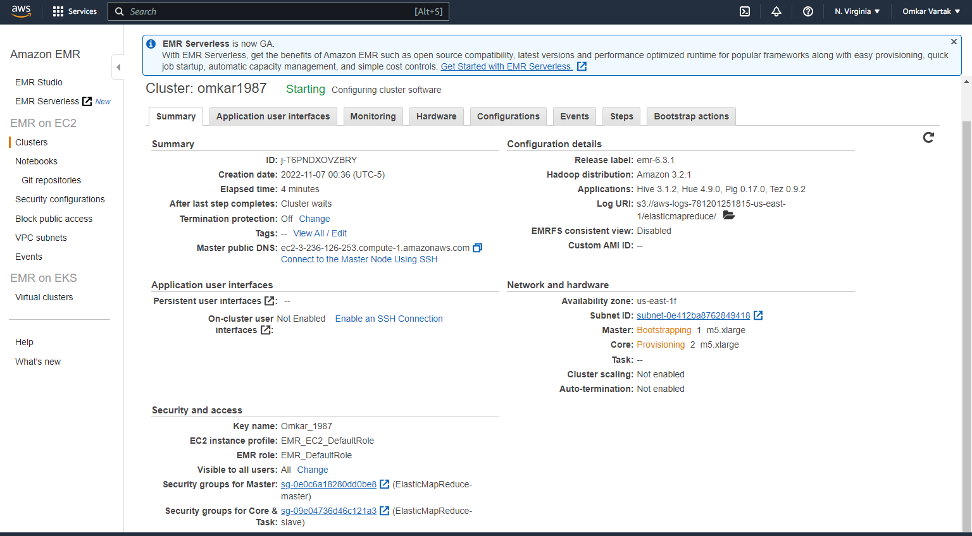
Creating the Cluster

Slide 5
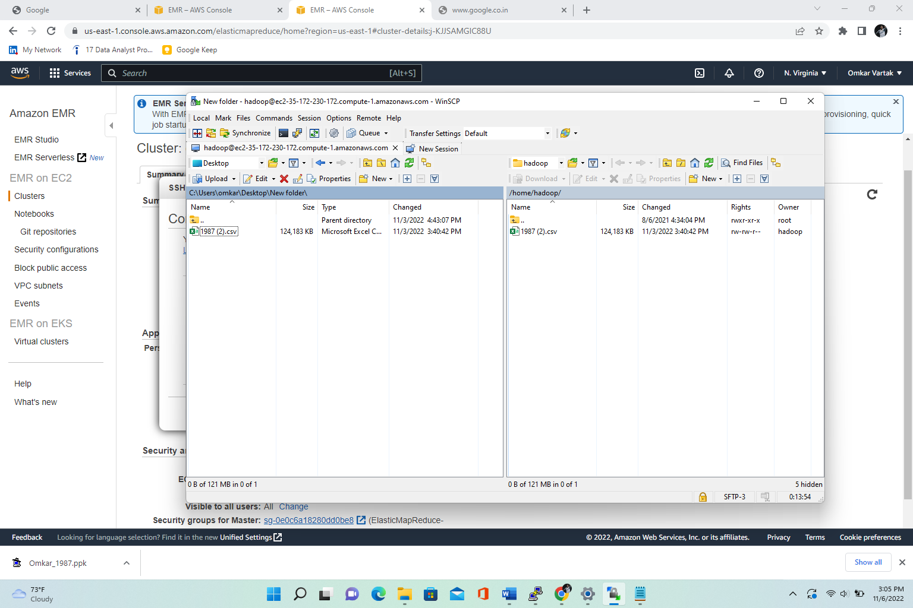
Using Winscp TO transfer files

Slide 6
Modify Hdfs
After this we will extract the downloaded bz2 file using any extractor.

Slide 7
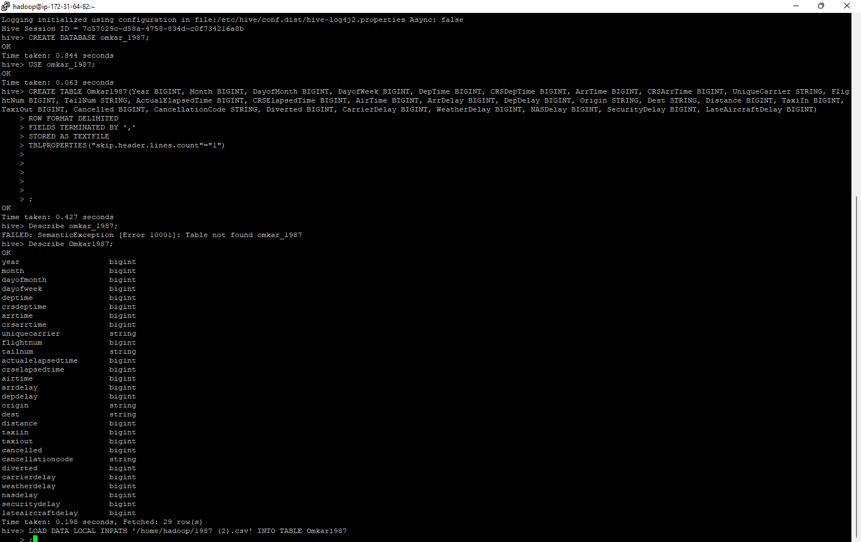
Creating Database and tables, Loading the data.

Slide 8
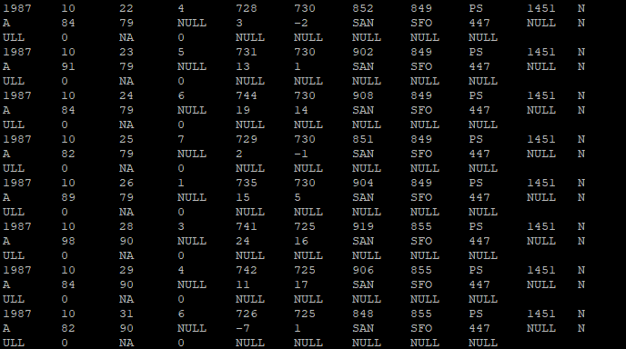
Displaying the Data using the limit function:-

Slide 9
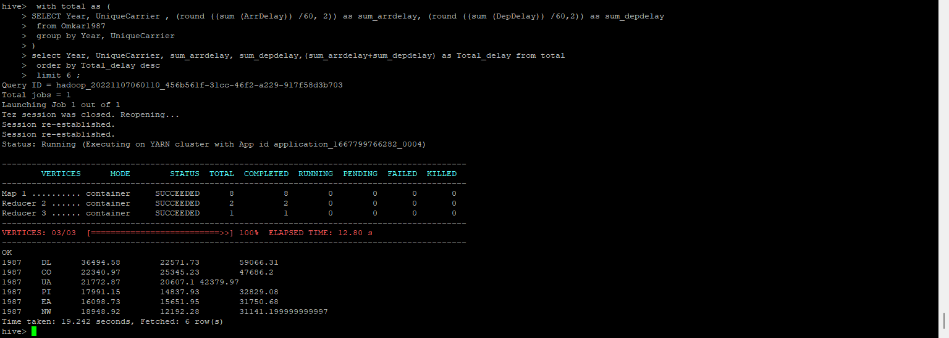
Query determine the three carriers with the highest delay time (in hours)

Slide 10
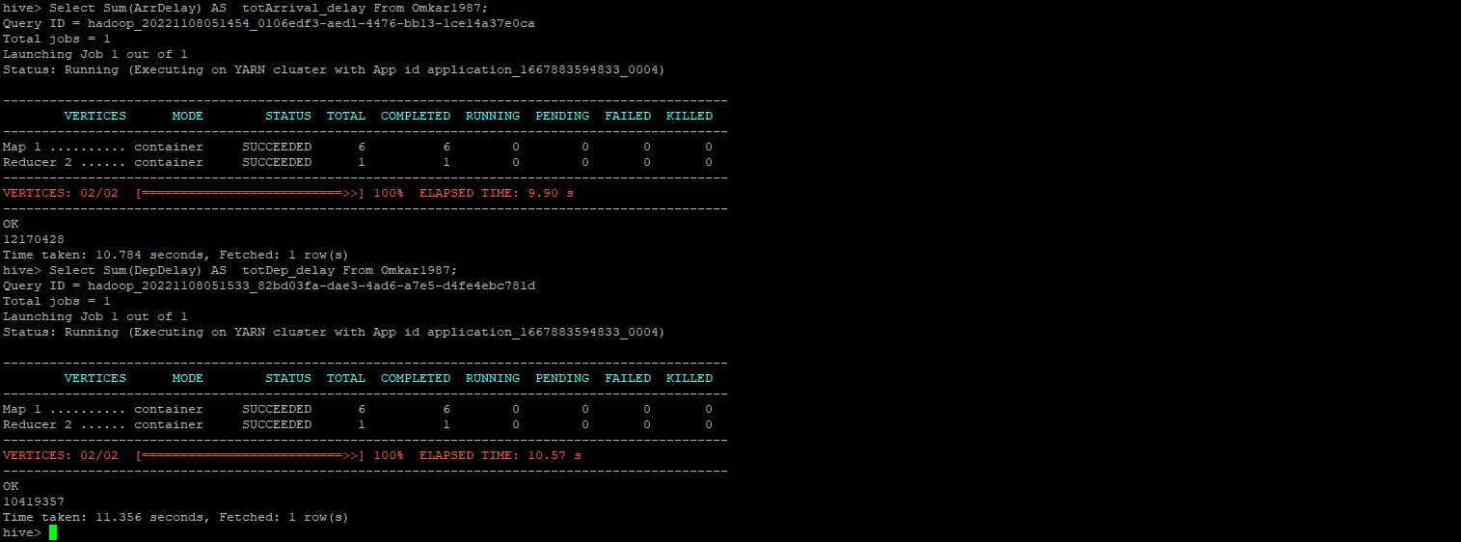
Query determine overall which type of delay (arrivals or departures) is the largest for airports

Slide 11
Query determine the three airports with the highest delay time (in hours)
We will divide the result by 60, In order to get the results in hours we will then use the round function.
After that we will get the result in hours which can be used in the visualization process.
Arr_delay = 12170428/60=202840.46
Dep_delay=10419357/60=173655.95
In conclusion Arrival delay is more than that of Departure delay

Slide 12
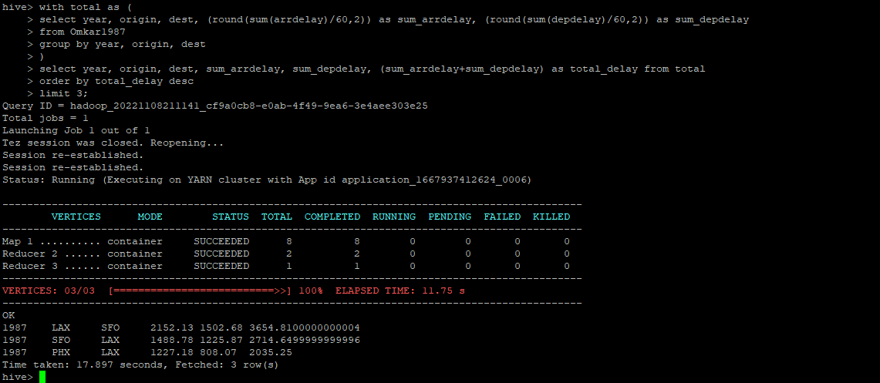
Query determine the three airports with the highest delay time (in hours)

Slide 13
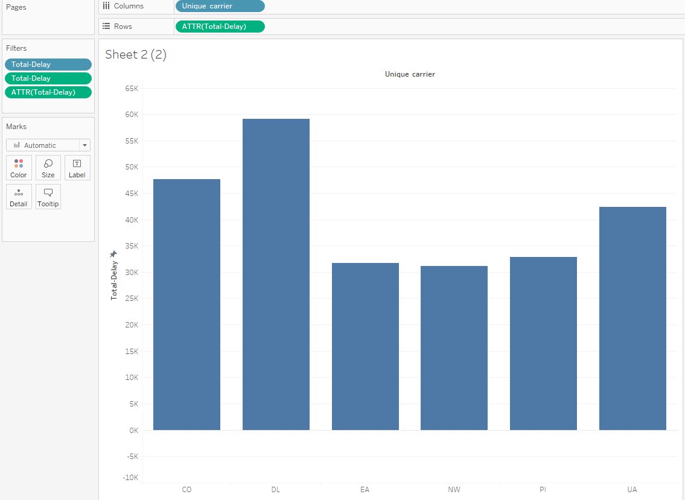
Visualization- tool used tableau for year 1987. determine the three carriers with the highest delay time (in hours)

Slide 14
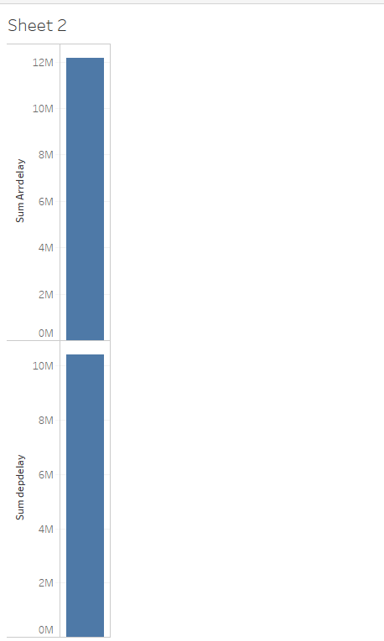
determine overall which type of delay (arrivals or departures) is the largest for airports

Slide 15
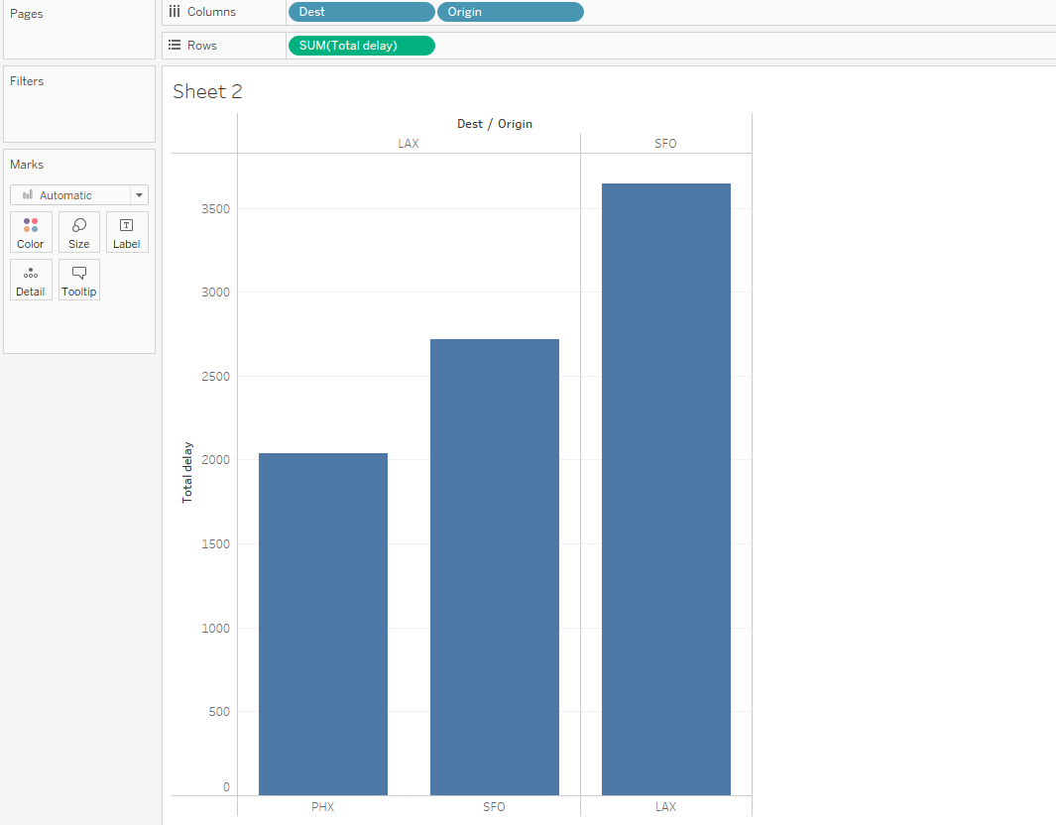
determine the three airports with the highest delay time (in hours

Slide 16
Shweta Sawant - Year Assigned 2006

Slide 17
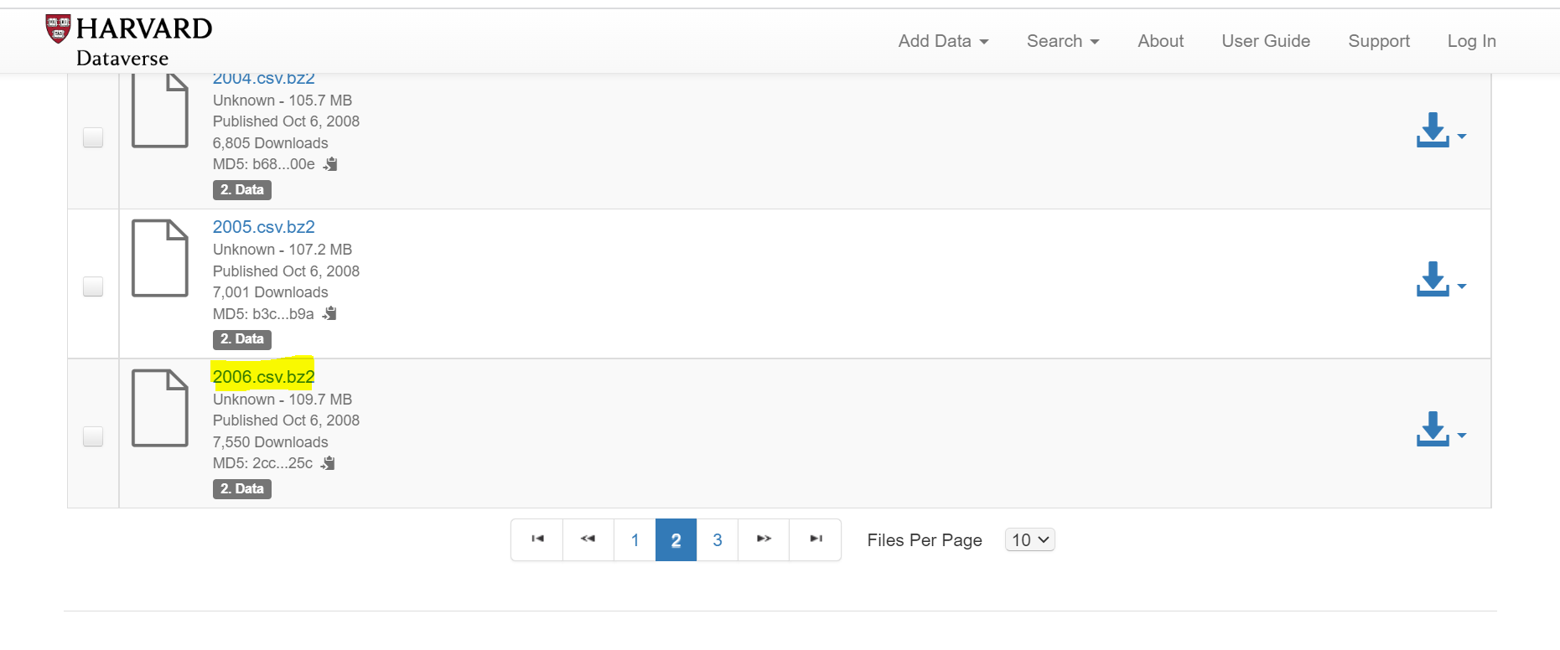
Downloaded the data from Harvard DATAVERSE :

Slide 18
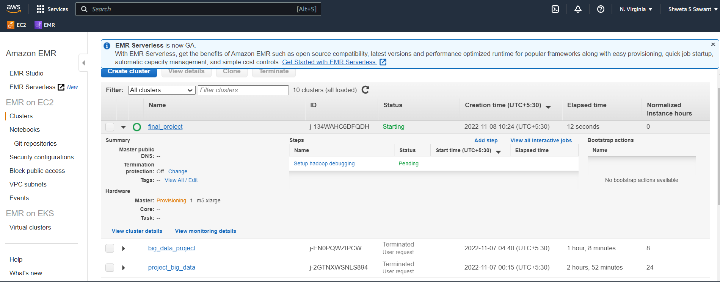
Creation of cluster

Slide 19
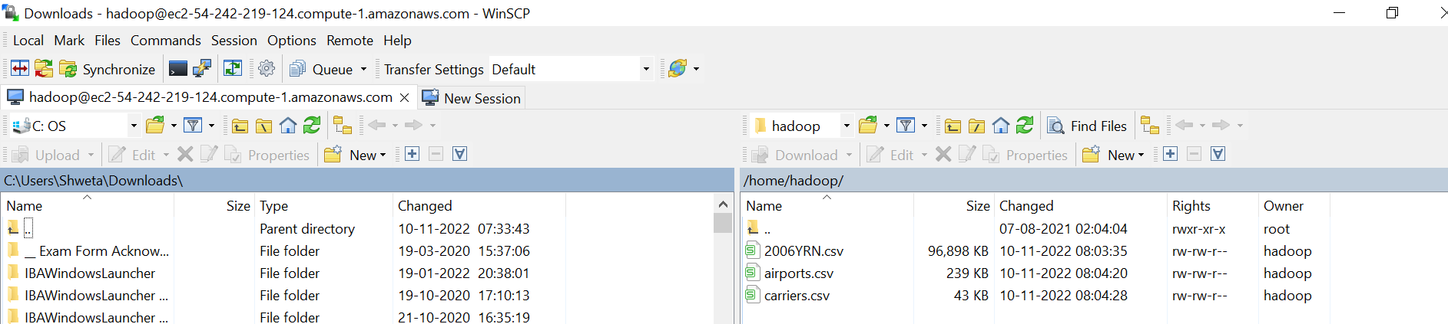
Extraction of 2006,airports and carriers data to WINSCP Software

Slide 20
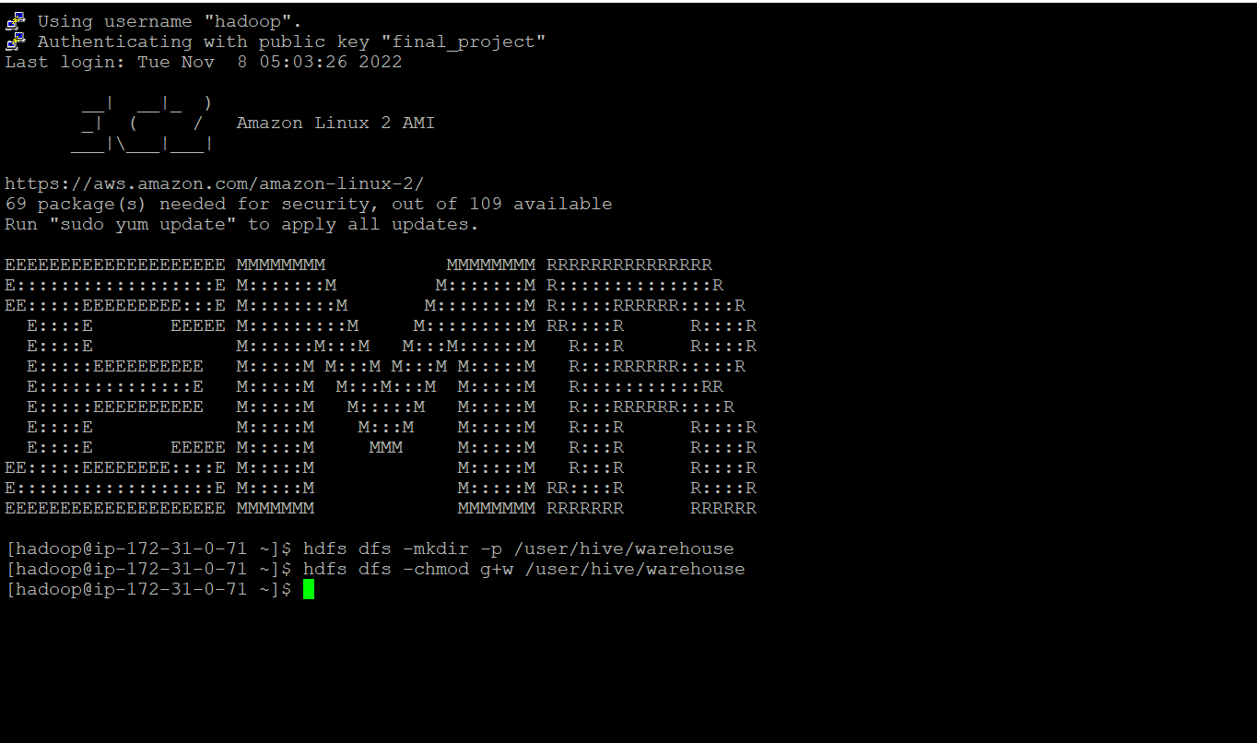
hdfs Commands
Below commands were used:
1. hdfs dfs -mkdir -p /user/hive/warehouse
2. hdfs dfs -chmod g+w /user/hive/warehouse

Slide 21
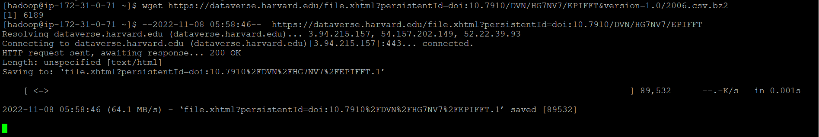
WGET Commands in HADOOP FOR 2006 DATA
wget https://dataverse.harvard.edu/file.xhtml?persistentId=doi:10.7910/DVN/HG7NV7/EPIFFT&version=1.0/2006.csv.bz2

Slide 22
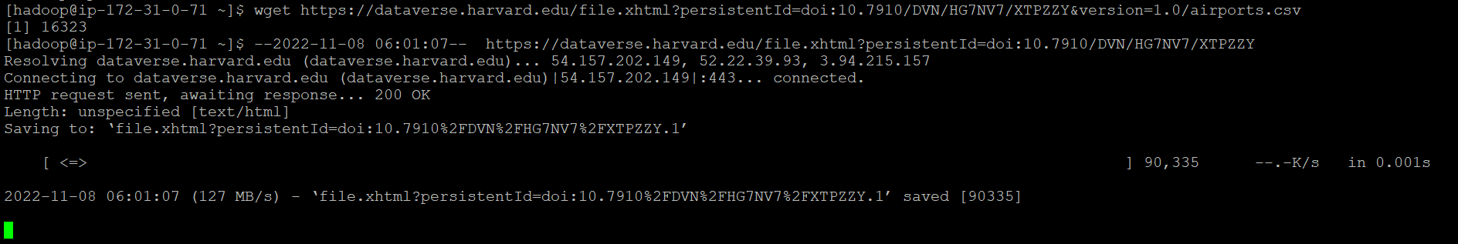
WGET Commands in HADOOP FOR AIRPORTS DATA
wget https://dataverse.harvard.edu/file.xhtml?persistentId=doi:10.7910/DVN/HG7NV7/XTPZZY&version=1.0/airports.csv

Slide 23

WGET Commands in HADOOP FOR CARRIERS DATA
wget https://dataverse.harvard.edu/file.xhtml?persistentId=doi:10.7910/DVN/HG7NV7/3NOQ6Q&version=1.0/carriers.csv

Slide 24
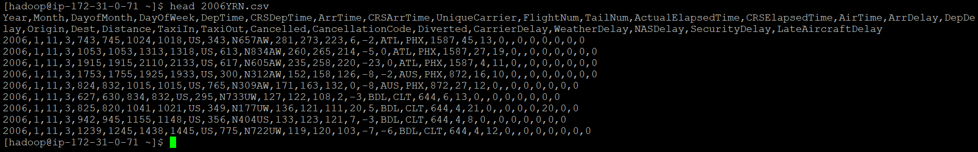
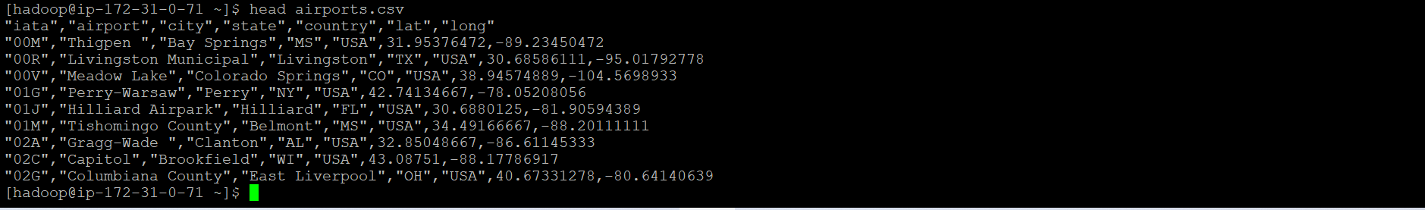
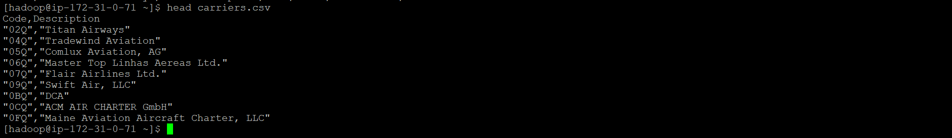
Vewing 2006, airports & carriers data

Slide 25
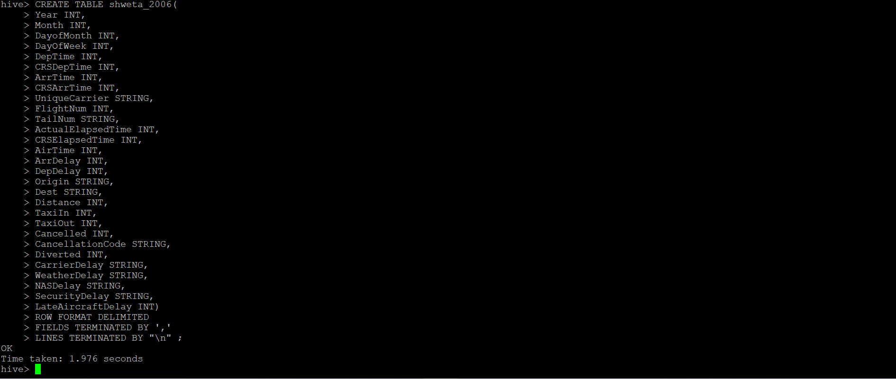
Creating 2006 Database and tables, Loading the data.
2006 Table

Slide 26
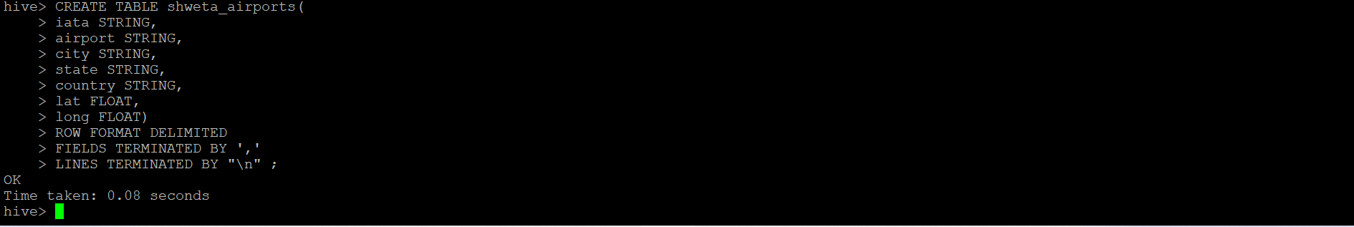
Creating AIRPORTS Database and tables, Loading the data.
Airports Table

Slide 27
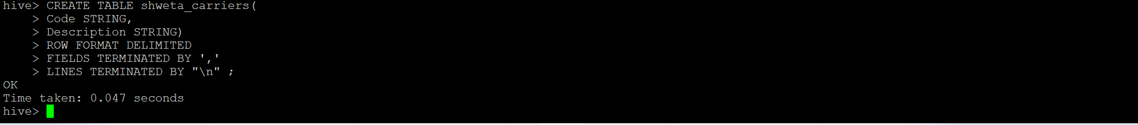
CreatingCARRIERS Database and tables, Loading the data.
Carriers Table

Slide 28
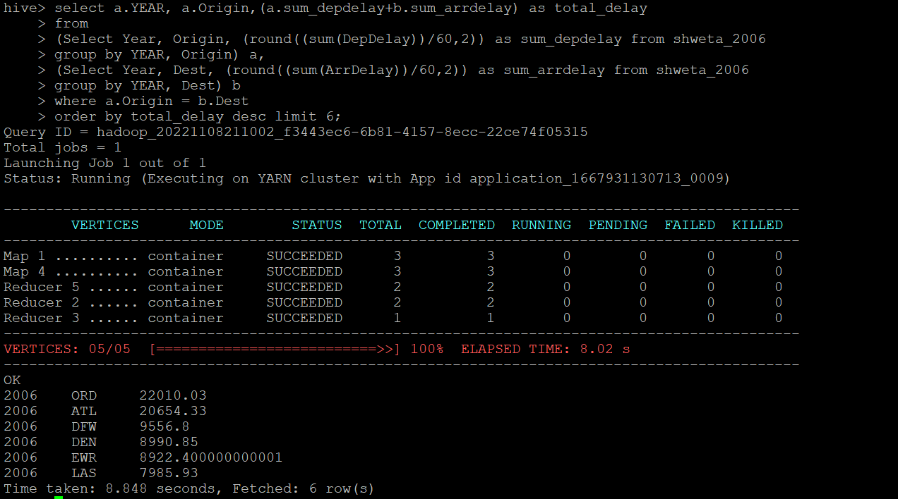
Query to determine the three airports with the highest delay time (in hours)

Slide 29
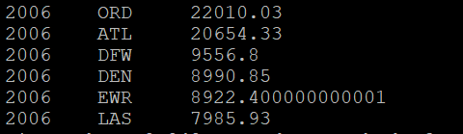
OUTPUT OF QUERY 1:
Year | Origin | Total Delay | Airport
2006 | ORD | 22010.03 | Chicago O'Hare International
2006 | ATL | 20654.33 | William B Hartsfield-Atlanta Intl
2006 | DFW | 9556.8 | Dallas-Fort Worth International

Slide 30
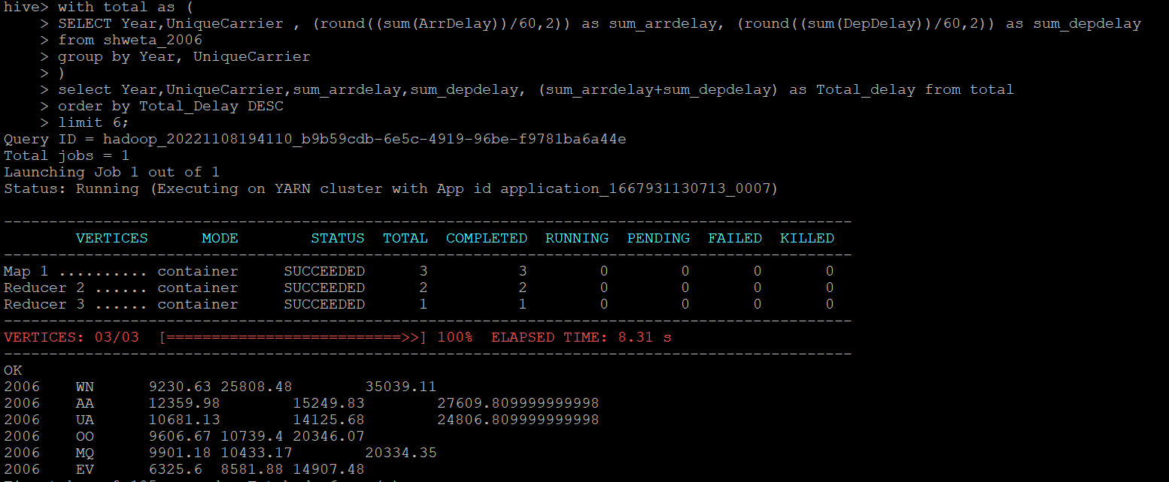
QUERY TO determine the three carriers with the highest delay time (in hours)

Slide 31
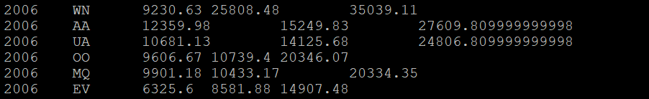
OUTPUT OF QUERY 2:
Year | Unique Carrier | Sum of Arr Delay | Sum of Dep Delay | Total delay
2006 | WN | 9230.63 | 25808.48 | 35039.11
2006 | AA | 12359.98 | 15249.83 | 27609.8
2006 | UA | 10681.13 | 14125.68 | 24806.8

Slide 32
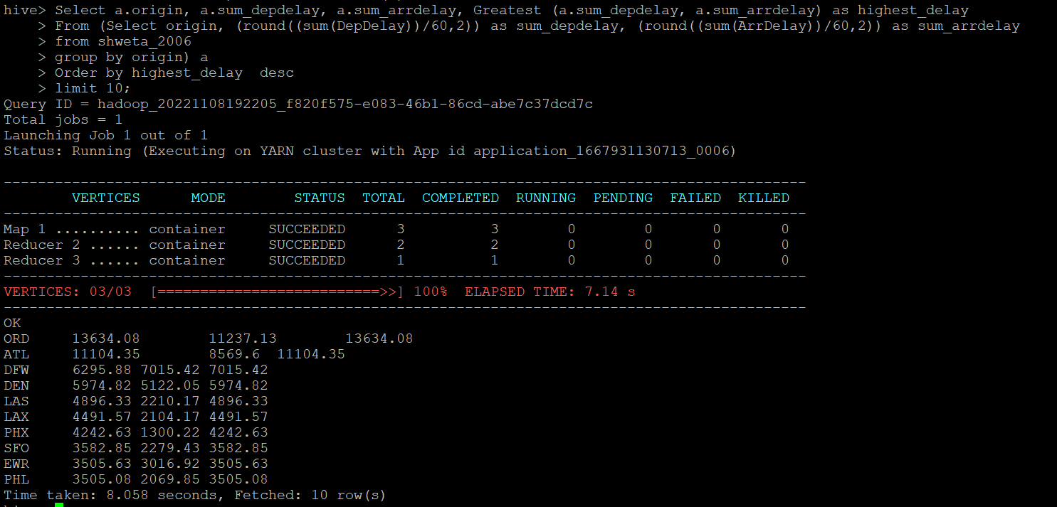
QUERY TO determine overall which type of delay (arrivals or departures) is the largest for airports

Slide 33
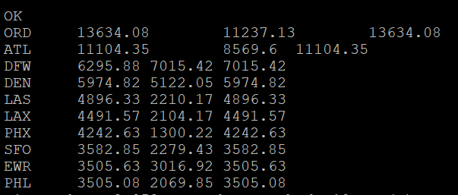
OUTPUT OF QUERY 3:
Origin | Sum of Dep Delay | Sum of Arr Delay | Highest Delay
ORD | 13634.08 | 11237.13 | 13634.08
ATL | 11104.35 | 8569.6 | 11104.35
DFW | 6295.88 | 7015.42 | 7015.42

Slide 34
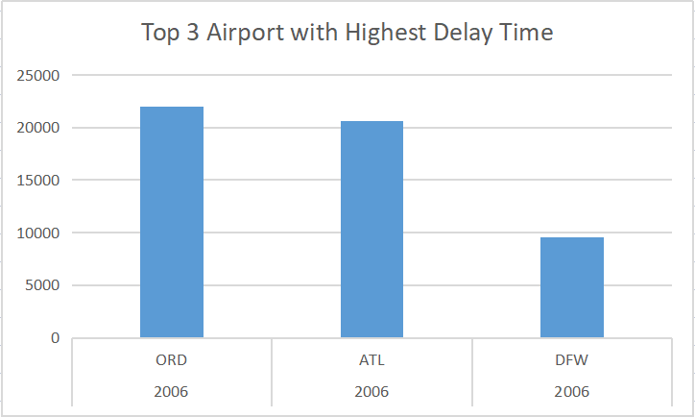
Visualization for year 2006 determine the three AIRPORTS with the highest delay time (in hours)

Slide 35
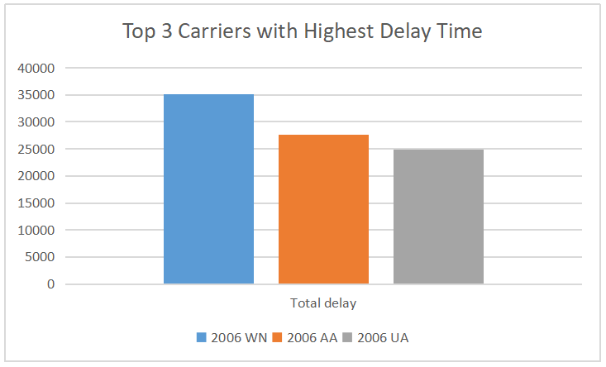
Visualization for year 2006 determine the three carriers with the highest delay time (in hours)

Slide 36
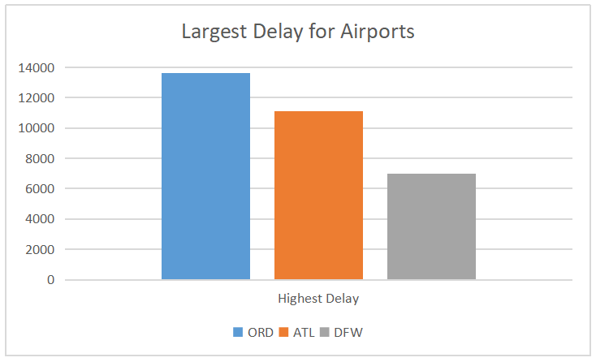
Visualization for year 2006 determine which type of delay is the largest for AIRPORTS (in hours)

Slide 37
Bigdata –Project-01
Kavya Nallajerla
Assigned Year
1991

Slide 38
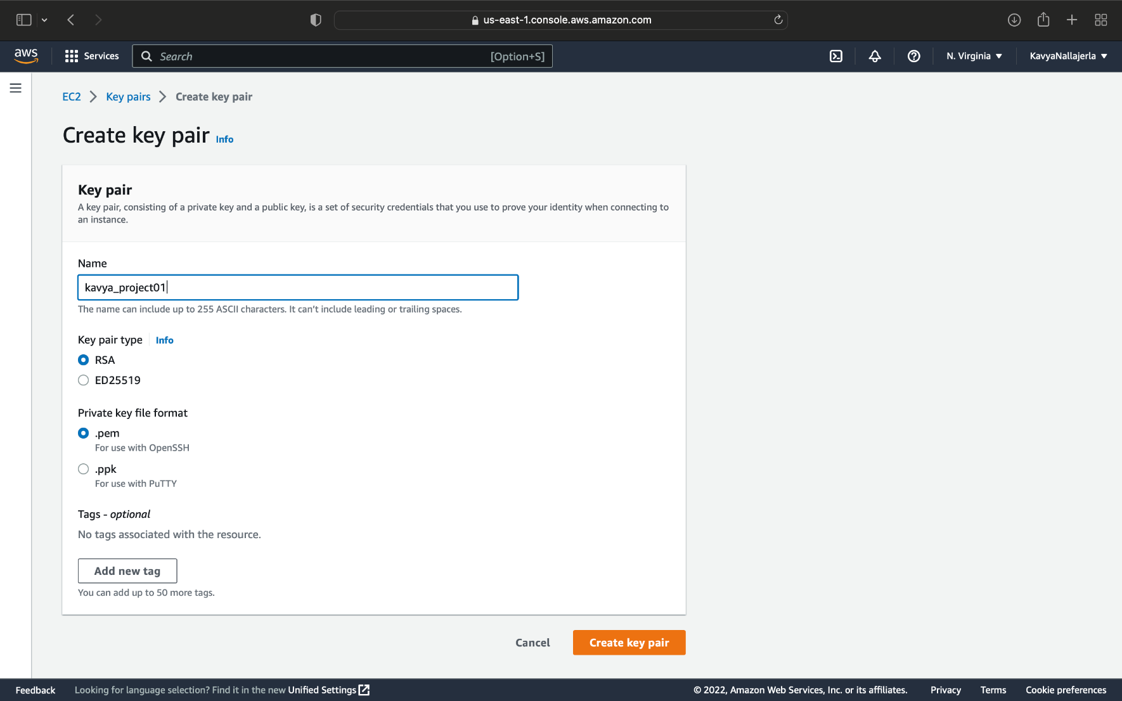
Create keypair

Slide 39
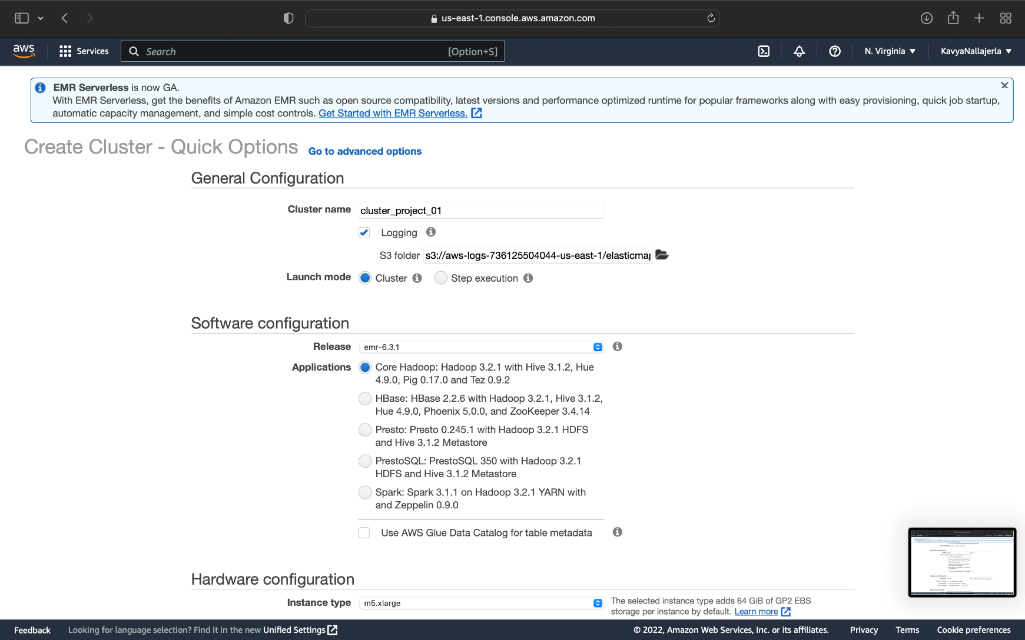
Creating Cluster

Slide 40
Fetching Data
AS Using Mac Fetchingh data With the help of Wget
wget https://dataverse.harvard.edu/api/access/datafile/:persistentId?persistentId=doi:10.7910/DVN/HG7NV7/EJ4WJO -O 1991.csv.bz2
After this we will extract the downloaded bz2 file using any extractor
bzip2 -d 1991.csv.bz2

Slide 41
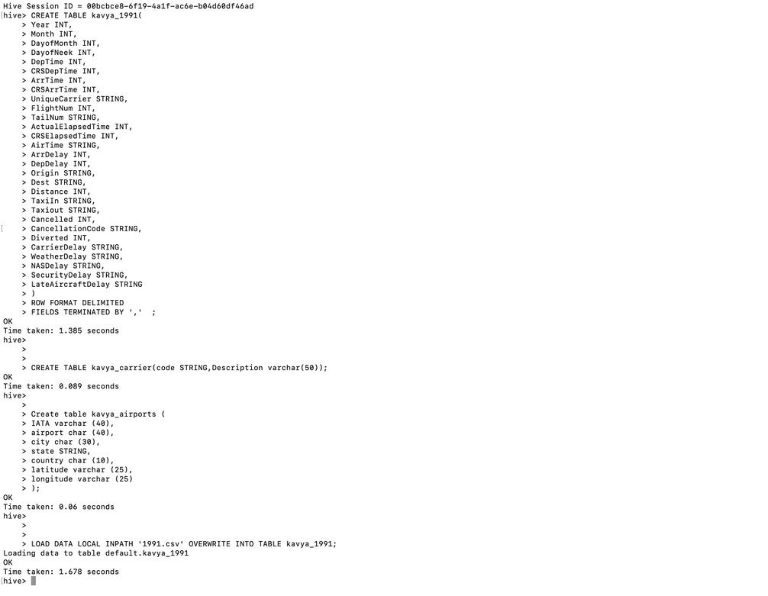
Creating tables for the data

Slide 42
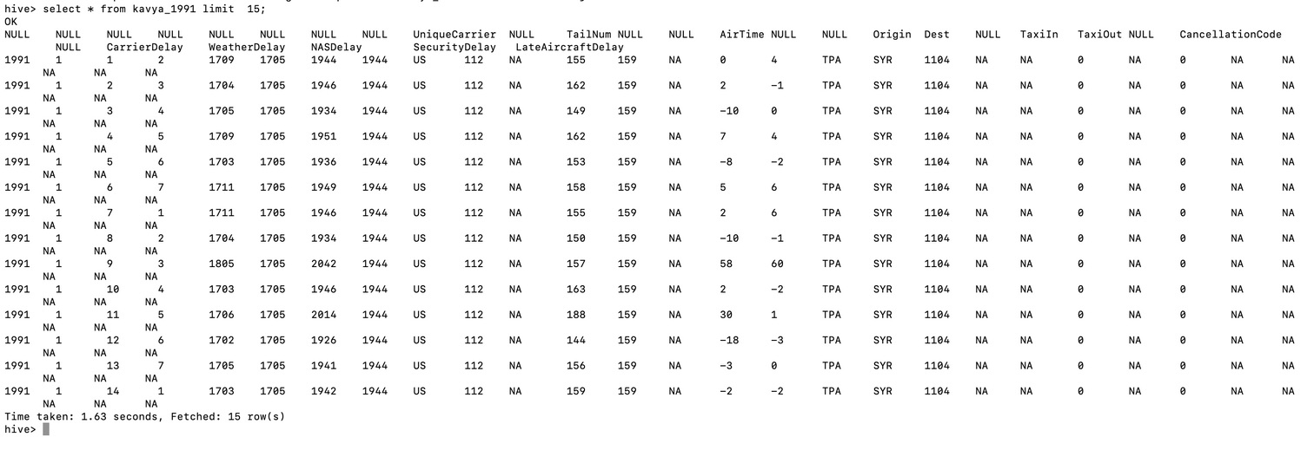
Displaying the Data using the limit function

Slide 43
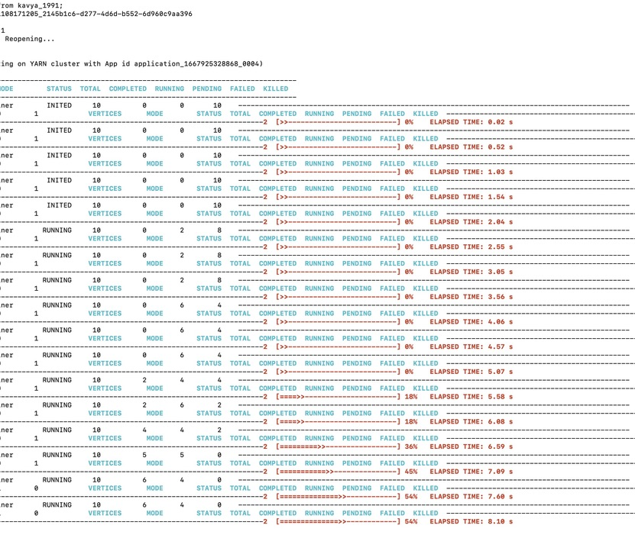
select count(*) from kavva 1991:

Slide 44
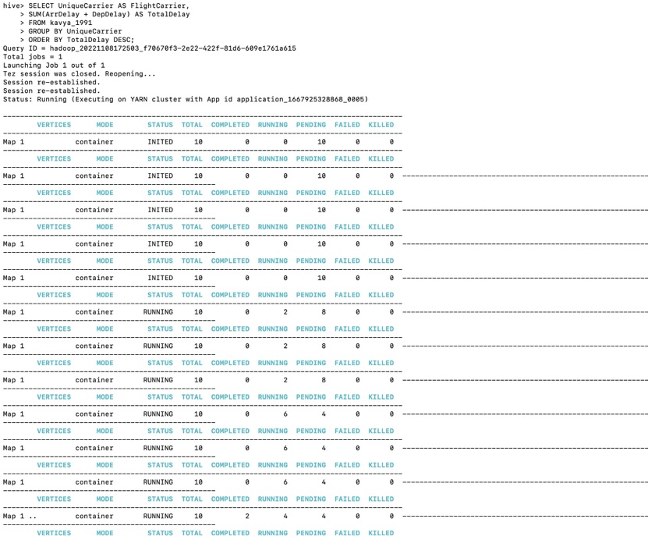
Determine the three carriers with the lowest delay time (in hours) for your year

Slide 45
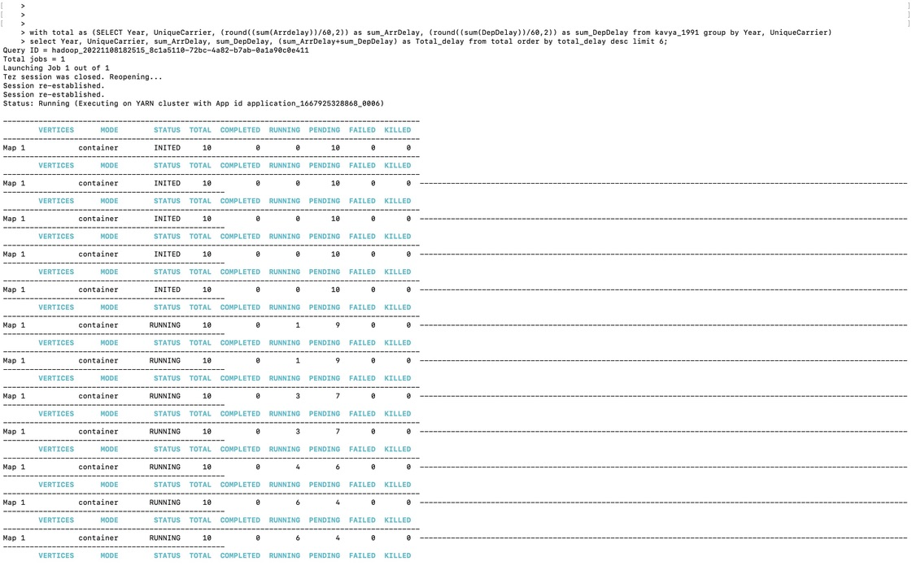
Determined 3 carriers with highest delay time

Slide 46
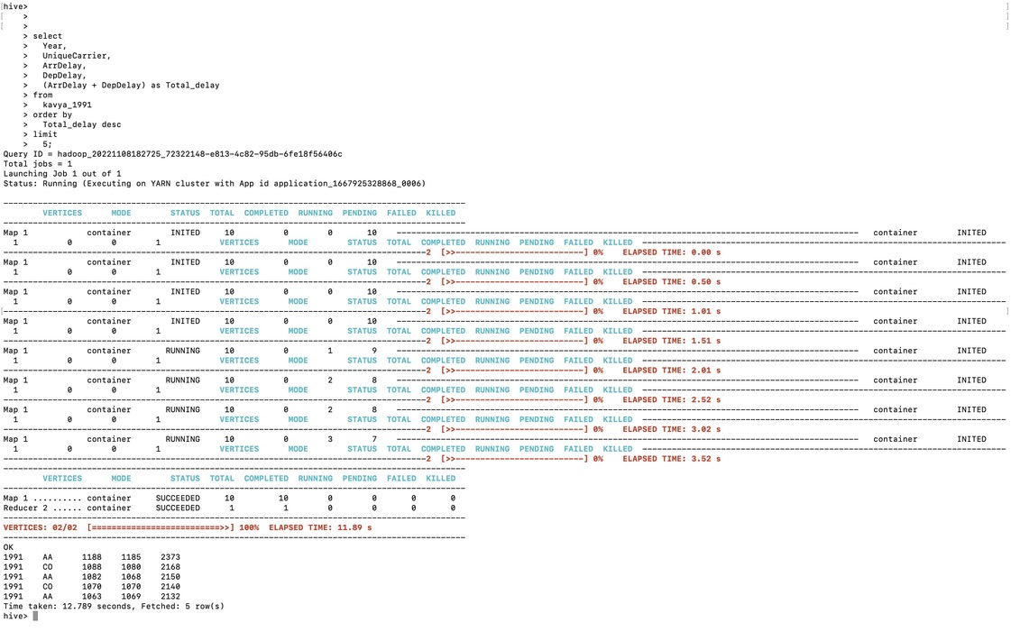
Queryto determine the three airports with the highest delay time (in hours)

Slide 47
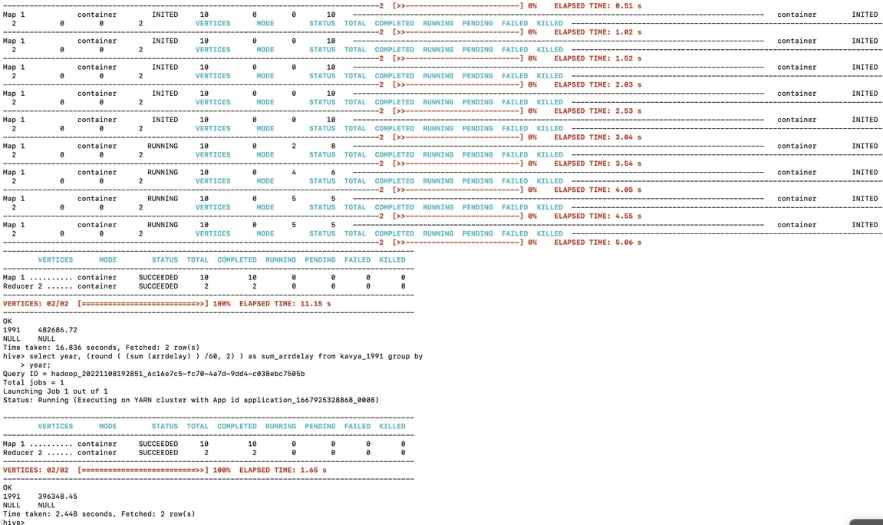

Slide 48
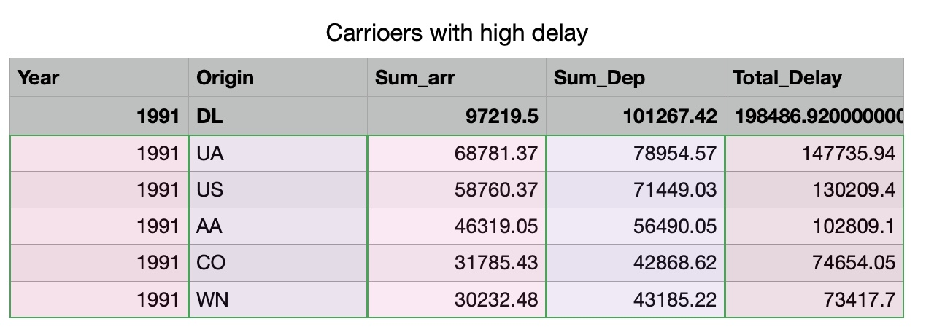
Table View

Slide 49
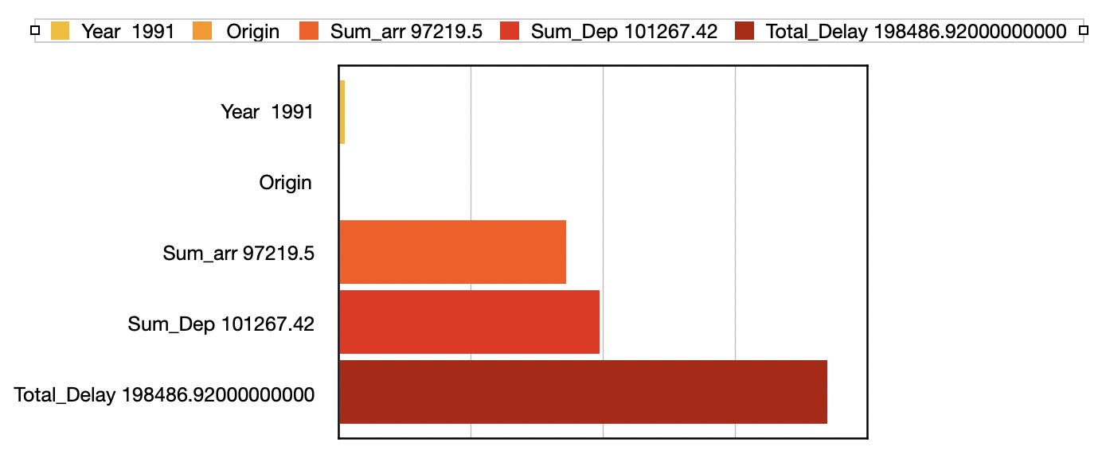

Slide 50
SINDHUJA PULUMATI- YEAR 1996

Slide 51
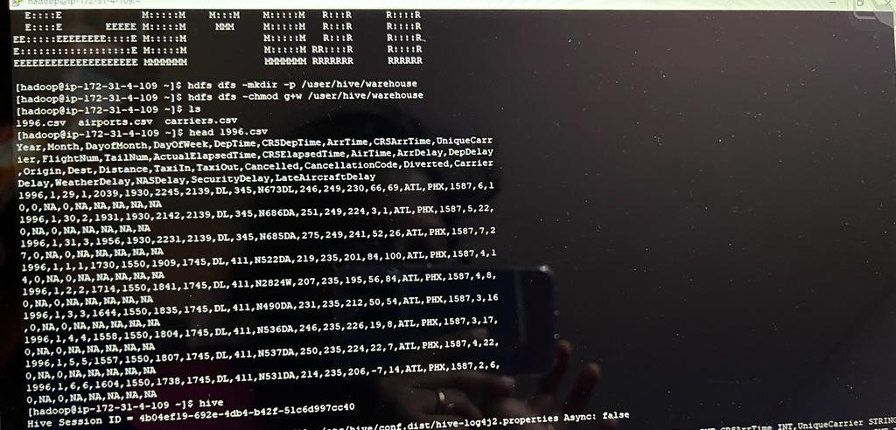
LOADING THE EXCEL FILES IN PUTTY

Slide 52
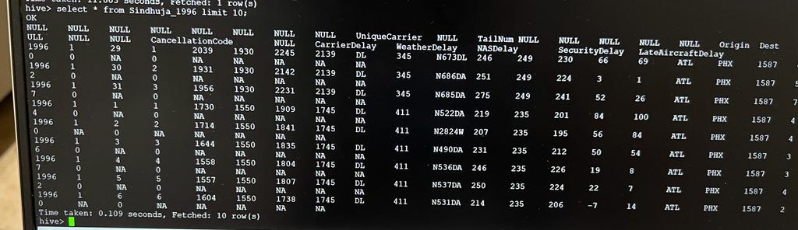
DISPLAYING THE DATA USING LIMIT

Slide 53
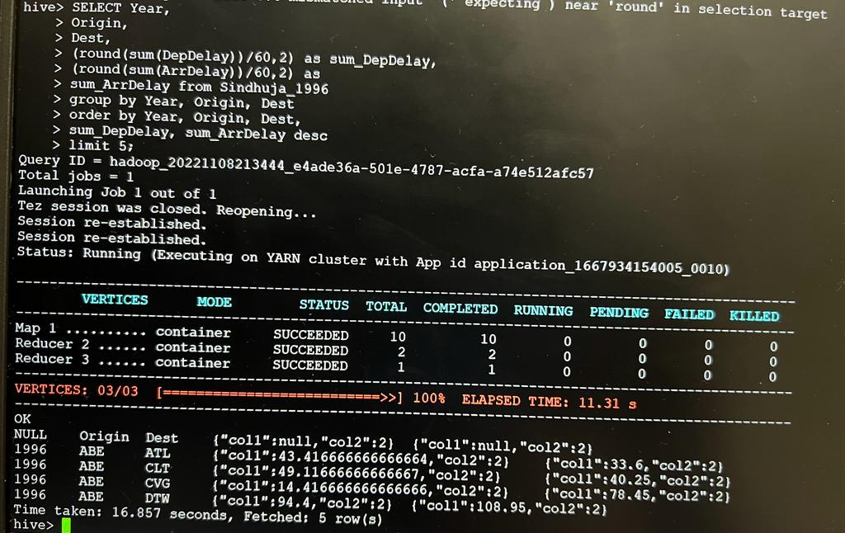
QUERY TO DETERMINE 3 AIRPORTS WITH HIGHEST DELAY

Slide 54
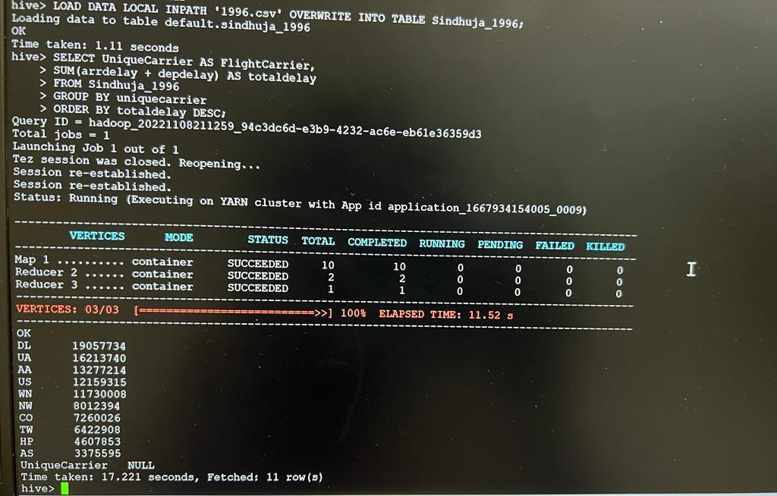
QUERY TO DETERMINE 3 CARRIERS WITH HIGHEST DELAY

Slide 55
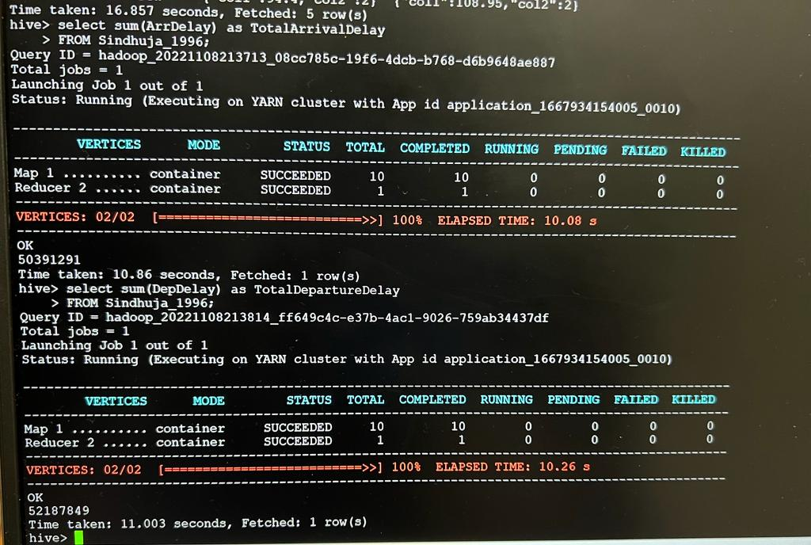
QUERY TO DETERMINE OVERALL WHICH TYPE OF DELAY IS THE LARHEST CONTRIBUTOR

